Slide 1
Lecture 11.6 Transfer pricing

Slide 2
Transfer Pricing
When one division transfers something (a good or service) to another, it usually charges a transfer price.
What should that price be?
Important because: “The choice of transfer-pricing method does not merely reallocate total company profits among business units, but affects the firms total profits”.
Transfer pricing determines incentives.
May encourage inappropriate outsourcing if the price is set too high
May encourage too much internal investment if the price is too low.
We ignore tax issues, but note that these are likely to be important. For example, IKEA and firms that shift profits back to Ireland or Singapore…

Slide 3
Transfer Pricing – perfect information
The optimal transfer price for a product or service is its opportunity cost: the value foregone by not using the product transferred in its next best alternative
Transfer pricing with costless information:
Assume MC = $3 and that the US plant has excess capacity.
Making in US and transferring it to Europe means it can be sold @ $5.
Not manufacturing means saving $3 but foregoing $5 in European revenue
Manufacturing in US and transferring gives net receipt of $2.
Here the opportunity cost or resources foregone by transferring it from the US to Europe is $3 which in this case is the actual marginal cost of production.

Slide 4
Transfer Pricing – perfect information
But what if the US division could sell the intermediate input for $6 in the United States? That is, the marginal revenue from selling it to an external firm in the United States is $6.
Further assume that it does not have excess capacity and so cannot sell in the US and to the European profit centre.
In this case, the opportunity foregone by transferring it to the European profit centre is not $3 (the MC of production), but rather $6 (which is actually the MR foregone).
Here, it would be optimal to sell externally rather than transfer.
By setting price equal to opportunity cost, the European division will purchase (and the US division sell) just the right amount.

Slide 5
Transfer Pricing – asymmetric information
In this example we assumed we knew:
Marginal cost of production
Intermediaries external price
European marginal revenue
Excess capacity in the US.
These may be known or they may not be known. In a large organisation we would expect that that this information would be distributed among different individuals/ organisational units. Hence the decentralisation of decision rights.
However, individual divisions may be in conflict when setting transfer prices. Lets consider the problem when one part of a firm (call it the Manufacturing division) has some information which is important in context of a transfer pricing decision.

Slide 6
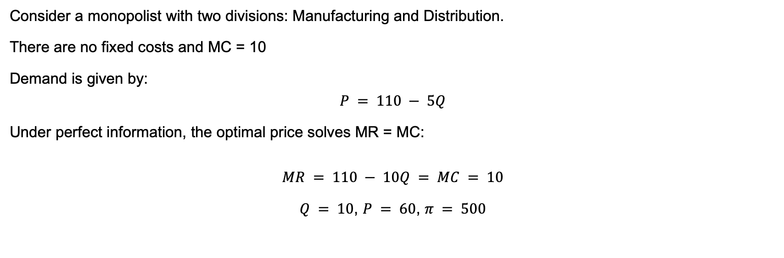
Transfer Pricing – asymmetric information
Consider a monopolist with two divisions: Manufacturing and Distribution.
There are no fixed costs and MC = 10
Demand is given by:
$$P = 110 − 5Q$$
Under perfect information, the optimal price solves MR = MC:
$$MR = 110 − 10Q = MC = 10$$
$Q = 10$, $P = 60$, $π = 500$

Slide 7
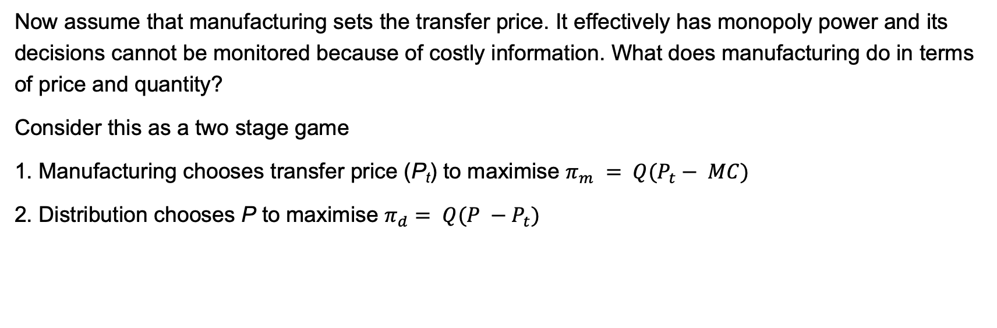
Transfer Pricing – asymmetric information
Now assume that manufacturing sets the transfer price. It effectively has monopoly power and its decisions cannot be monitored because of costly information. What does manufacturing do in terms of price and quantity?
Consider this as a two stage game
1. Manufacturing chooses transfer price (P_{t}) to maximise $π_{m} = Q(P_{t}− MC)$
2. Distribution chooses P to maximise $π_{d}= Q(P −P_{t})$

Slide 8
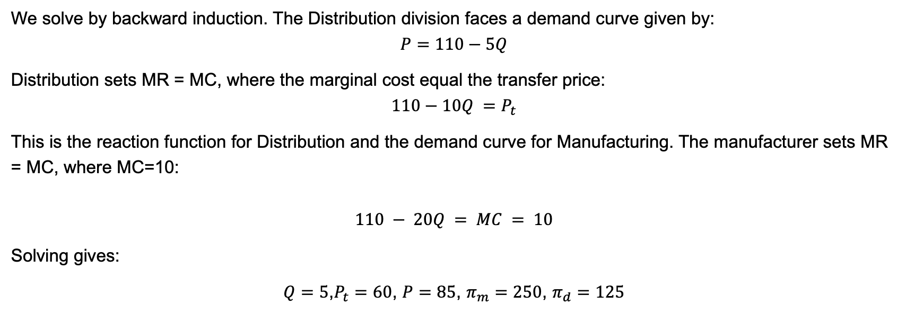
Transfer Pricing – asymmetric information
We solve by backward induction. The Distribution division faces a demand curve given by:
$$P=110−5Q$$
Distribution sets MR = MC, where the marginal cost equal the transfer price:
$$110−10Q =P_{t}$$
This is the reaction function for Distribution and the demand curve for Manufacturing. The manufacturer sets MR = MC, where MC=10:
$$110 − 20Q = MC = 10$$
Solving gives:
$Q=5$,$P_{t}=60$, $P=85$, $π_{m}=250$, $π_{d}=125$

Slide 9
Transfer Pricing – asymmetric information
110
Manufacturing
110
Distribution
85
60
MC_{m}=60
10
Q
Q
5
11
5
22

Slide 10
Transfer Pricing – asymmetric information
When the transfer price of $10 was charged, firm profits equalled $500.
When they act in their own interests with private information, firm profits equal $375, with manufacturing reporting profits of $250 and distribution profits of $125.
We can think of this as a problem similar to double marginalisation. Successive monopolies (this time inside the firm) reduce the quantity traded and decrease overall profit. The optimal transfer price is MC = 10, but this gives no profits to the Manufacturing division.
With a transfer price of $60, the opportunity cost to the firm of producing extra units of output are overstated. The Manufacturing division does not consider the externality of its transfer price.

Slide 11
Transfer Pricing – asymmetric information
There are a number of problems leading to this:
Asymmetric information.
Structure of rewards and performance evaluation – creates incentive to distort prices.
Challenge associated with where relevant knowledge lies about the capacity of divisions to sell internally and externally which will impact on the opportunity cost calculation
Who has the decision rights around pricing

Slide 12
How to set transfer prices
How could cost information be approximated?
Use market based prices by using a a competitive market as a benchmark: but the firm will produce internally precisely when competitive markets are less informative or unavailable
Use marginal cost transfer prices: but will cost information be accurately revealed? How can manufacturing cover its fixed costs? What if the marginal cost if not constant?
Use full-cost based transfer prices: accounting costs are verifiable, reducing information asymmetries, but they don’t accurately reflect opportunity costs
Use negotiated transfer prices: can help bound the transfer price between the marginal and market cost, and potentially enable the quantity to be set at that which maximises firm profit (to then be split). But can be costly and time consuming, relies on the skills of the negotiators and may potentially fail to find the firm profit maximising level.

